Slide 1
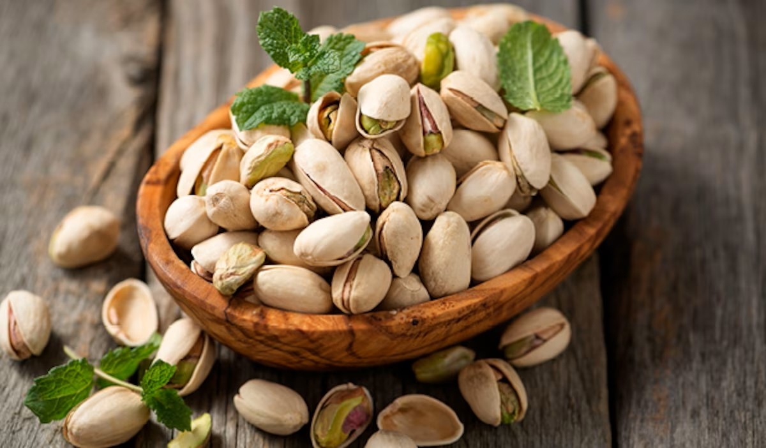
Pistachio Classification
Abi Sugiri RTM 021

Slide 2
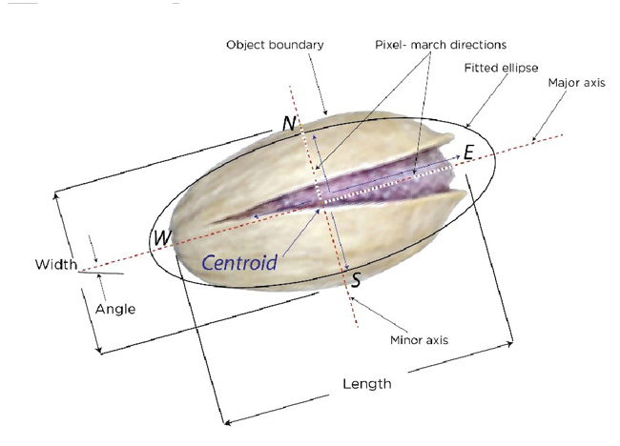
Introduction
Problem Background
Main Objective

Slide 3
Exploratory Data Analysis
Checking Data type
Missing Value
Cardinality
Basic Statistics:
Mean
Std.
Min.
Max.
Etc.

Slide 4
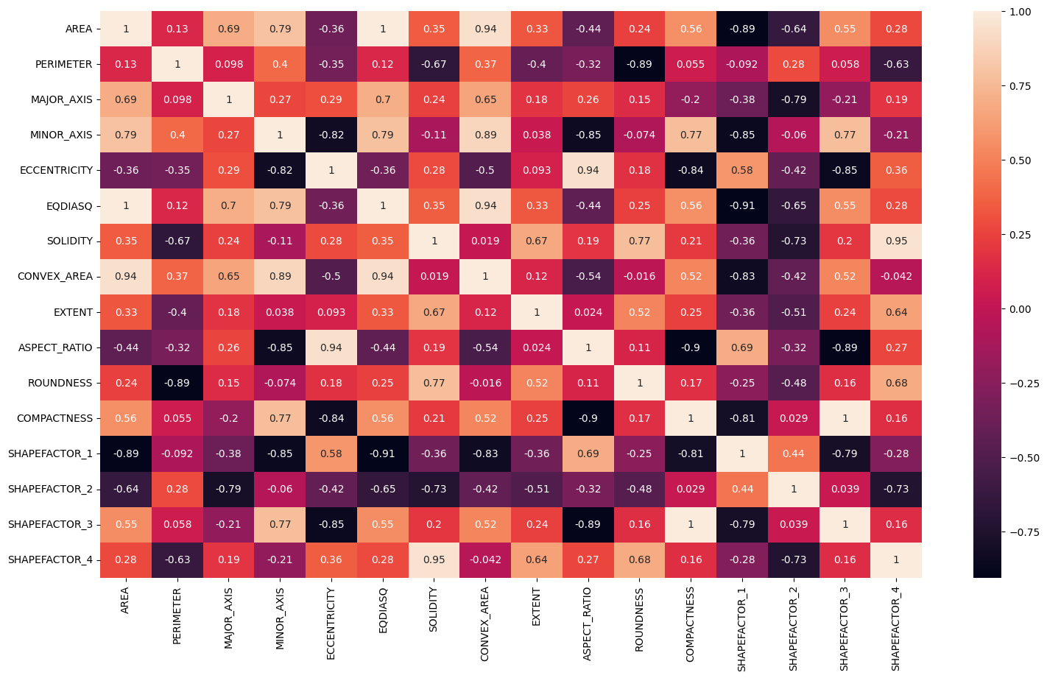
EDA

Slide 5
Feature Engineering (Preprocessing)
Feature Selection
Splitting into Features (X) and Target (y)
Splitting Dataset into Train and Testing set
Splitting into Nominal and Categorical columns
Outlier detection and Handling
Feature Scaling of Nominal Columns
Encoding of Categorical Column
Merging

Slide 6

Models
Support Vector Machine (SVM) - Classifier
Decision Tree Classifier (DT)
Random Forest Classifier (RF)
K Nearest Neighbors Classifier (KNN)
Naïve Bayes (NB)

Slide 7
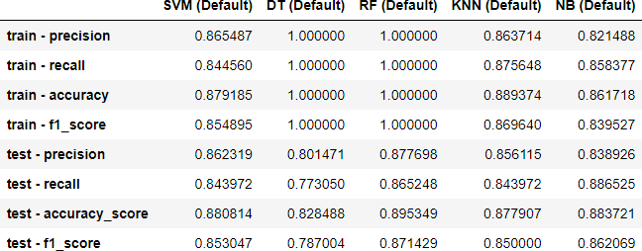

Slide 8
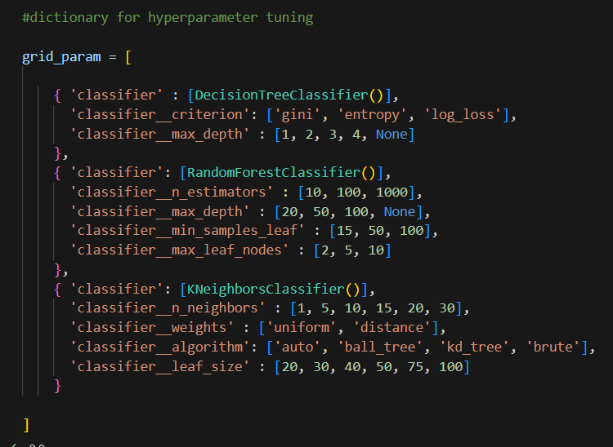
Model Improvement

Slide 9
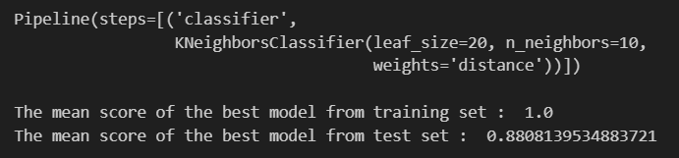
Model Improvement

Slide 10
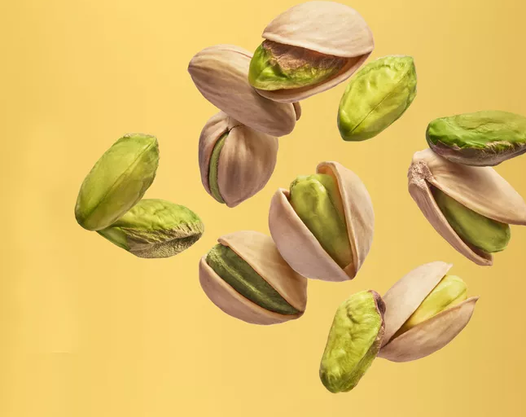
Thank You

